Slide 1
Introduction to Supervised and Unsupervised ML
Premkumar Chandra Shegaran

Slide 2
Agenda
Introduction: 9.30am – 9.40am
Intro to Machine Learning: 9.40am – 10.00am
Supervised Learning Algorithms and techniques: 10.00am – 10.30am
Break: 10.30am – 10.45am
USA dataset housing price/rental prediction: 10.45am – 12pm
Break: 12pm – 1.30pm
Titanic dataset classification: 1.30pm – 3pm
Unsupervised Learning briefing (very basic): 3pm – 3.30pm
End

Slide 3
About the Speaker

Slide 4






Professional Experience

Slide 5


Education

Slide 6





Seminars/Talks
Mentorship

Slide 7
Your turn..
First time to ALT.Labs?
Academics?
Business owners?
Data scientists?
Experience with data?

Slide 8
Welcome to ALT.labs Series 2

Slide 9
About
Monthly community event driven by passionate people to thrive in industry 4.0
Addresses the on-demand skillsets and technologies needed to survive in the current revolution: IOT, Cloud Computing, Robotics, AI&Big (Extreme) Data, and Cyber Security
To empower Malaysia to become a tech-driven state
To share and exchange knowledge, solve real world problems and most importantly, create an AWESOME community and to DISRUPT

Slide 10
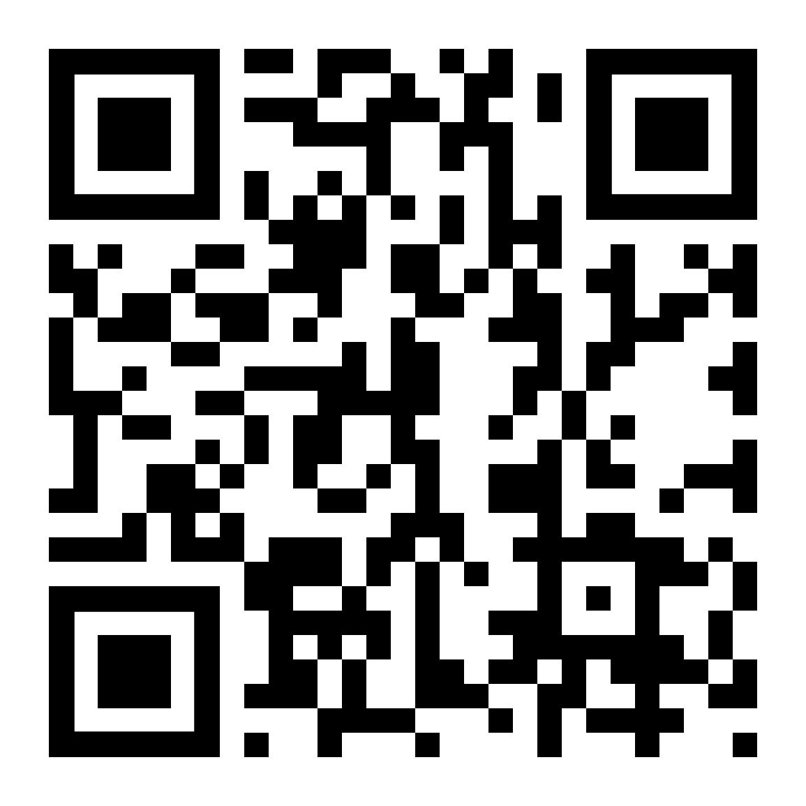
What you need to do..
Support us and the community by participating in the monthly co-labs
Join our LinkedIn site: https://bit.ly/2PX5qeR

Slide 11
Introduction to Supervised and (very basic) Unsupervised Learning

Slide 12
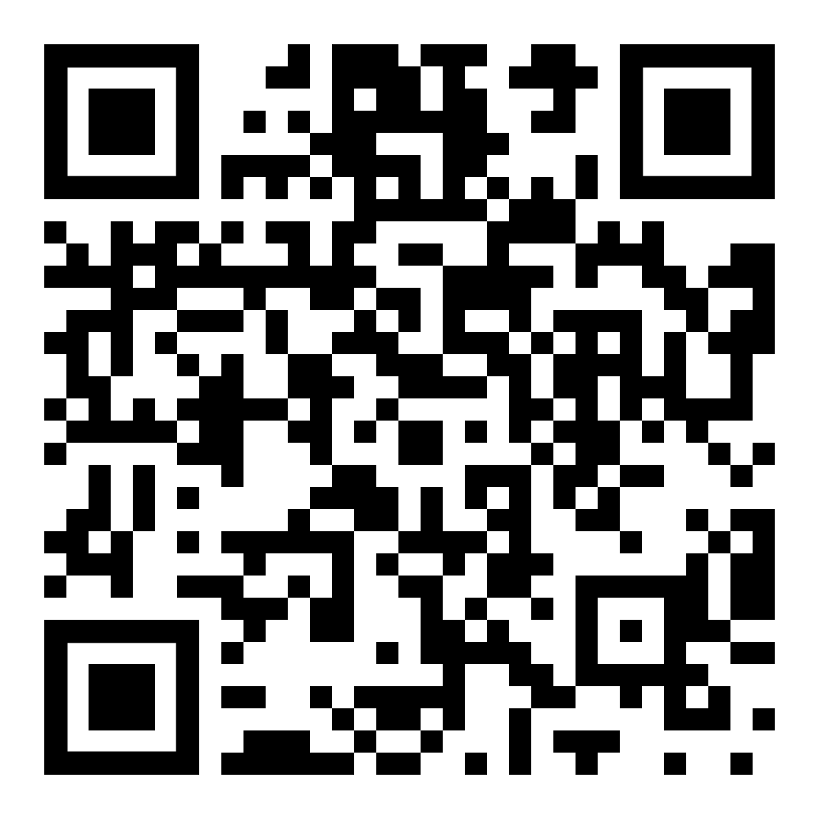
Download Course Materials
Github page: https://bit.ly/2JyDTz5

Slide 13
Introduction to Machine Learning

Slide 14
“[Machine Learning is the] field of study that gives computers the ability to learn without explicitly being programmed.”
–Arthur Samuel, 1959

Slide 15
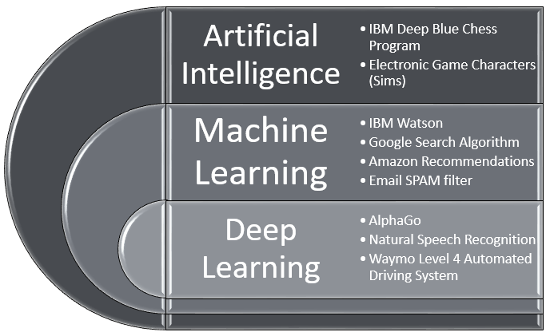
AI, Deep Learning, Machine Learning?

Slide 16

Credit Card Fraud detection
How would you do it?

Slide 17
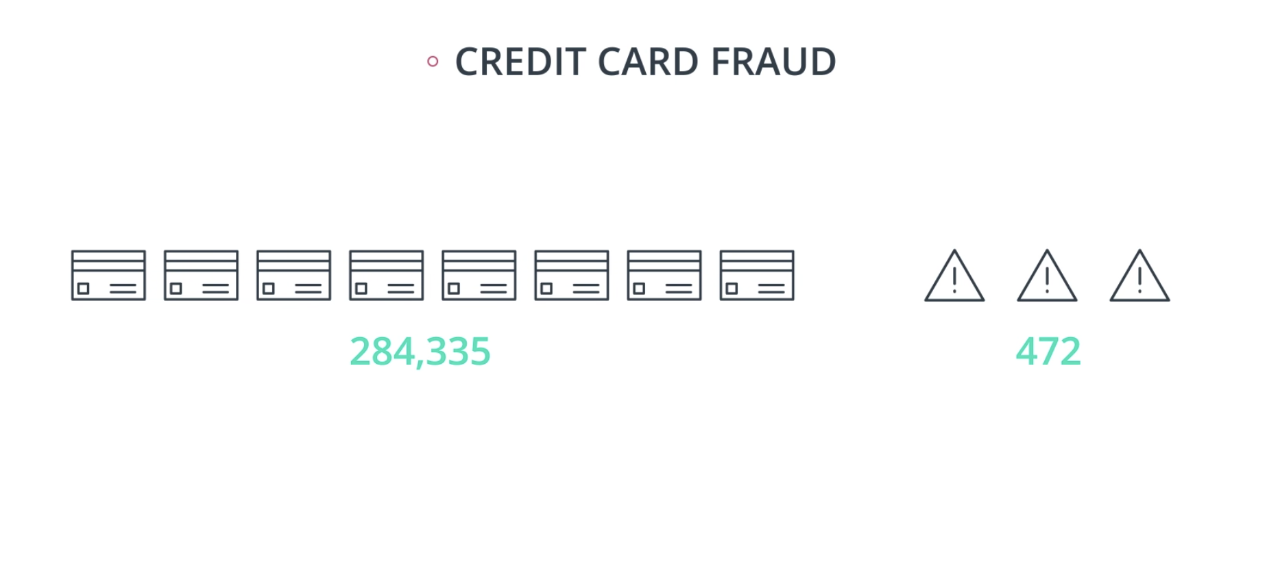

Slide 18


Housing price prediction
How would you do it?

Slide 19
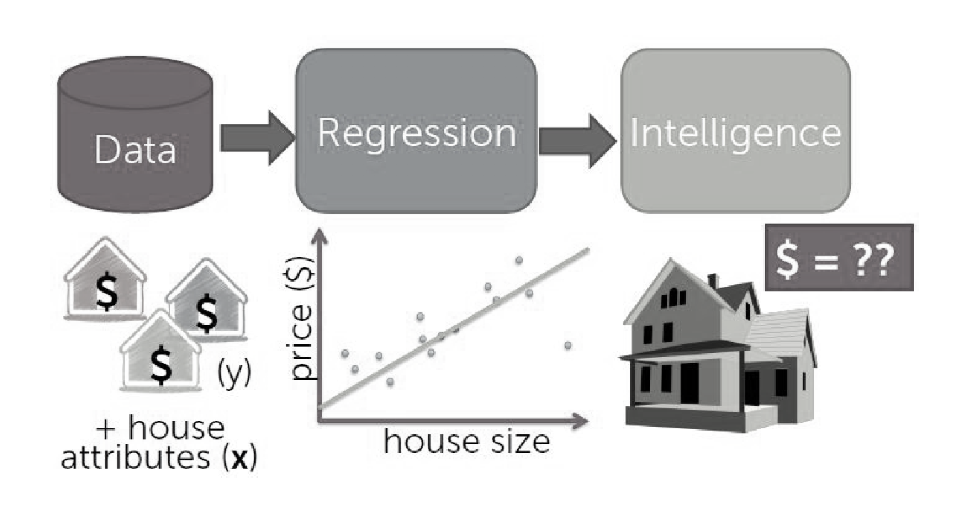

Slide 20

VS

Slide 21

VS
Identify me..

Slide 22






Real Estate
Chatbots, Investor analytics, Pending loan defaults, Deal matching, Property management
Telco
Monitor signal density, Churn prediction, Fraud detection, Improve service applications
Marketing
Customer segmentation, Sentiment analysis, Lead generation
Medical
Disease detection, Drug discovery, Medical bill estimation, Epidemic outbreak prediction
Manufacturing
Yield prediction, Smart manufacturing, Predicting supply chain
Energy
Upstream exploration, energy demand forecasting, Storage, Preventive maintenance

Slide 23
Analytic Value Escalator
Prescriptive
Predictive
Diagnostic
Value
Descriptive
Difficulty

Slide 24
Types of Machine Learning
Trained with human intervention or not: Supervised, Unsupervised,
Static or Dynamic systems: Batch vs Online learners
Learn from patterns or compare with known data points: Instance-based vs model-based

Slide 25
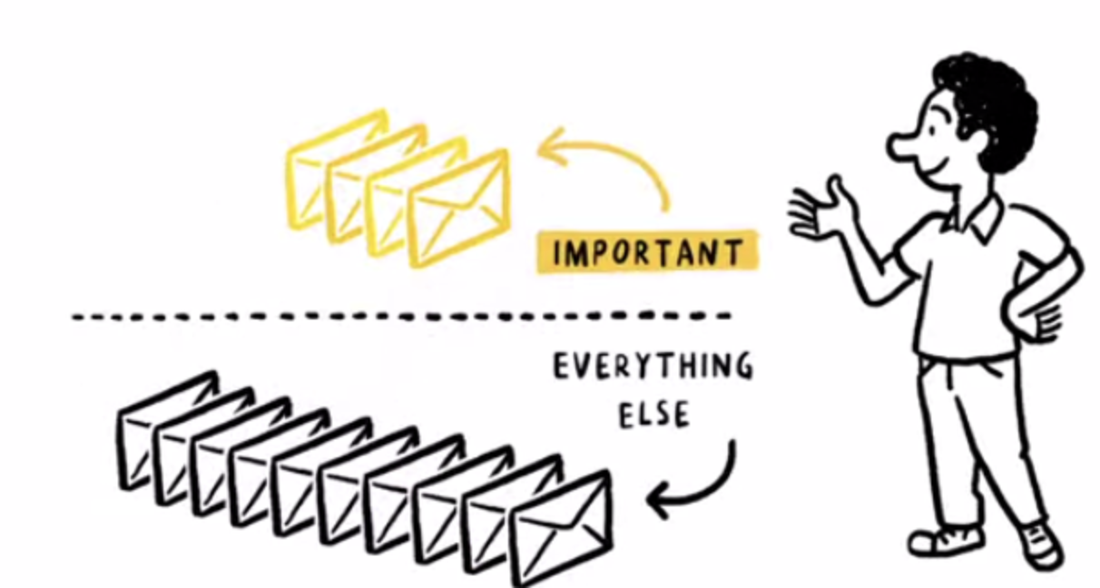
Supervised Learning
?
New Instance

Slide 26
Machine Learning Flow

Slide 27
Flowchart of ML problems
Problem Identification
Feature Engineering
Build Model
Data Collection
Prepare data for ML
Test Model
Data Cleansing
Split data to train and test
Refine and Optimize Model
Data Analysis
Performance measure
Test and validate model
Deploy model
Build API connector

Slide 28
Data Cleansing
Once imported as a pandas data frame, look out for:
Null Values
What
Data Type
Strings or Numbers?
Outliers
What
Why
How
Why
How

Slide 29
Data Analysis
EDA
Descriptive Stats
Categorical vs continuous vs time data
Plot Visuals
Also run dataframe.info or dataframe.describe to get better information

Slide 30
Split Data to Train and Test
Split to train and test
General rule: work only with train set, never touch the test set
Split the dataset into 70-90% training set and the balance as testing set depending on your data size.
Put the test set away and from now on, work only with the training set

Slide 31
Data Preprocessing
Once analysed, you may need to pre-process the data to :
Normalized skewed distributions
Perform feature engineering
Scale the data
Best approach is to write a Python Function for this so that it is repeatable on the testing set

Slide 32
Feature Engineering
Create new Features | Strings to word vectors | Combine features/dimensionality reduction
Create new features to check how it affects the target variable or how it affects between features. | ML algorithms generally do not work with strings and you need numbers for that reason. | Sometimes, you may also see a direct correlation between features, i.e one feature can be directly explained by another feature.

Slide 33
Prepare Data for ML
Scaled Features, no null values
Check the number of rows and see if they match the training dataset
Define a naïve model

Slide 34
Define Performance Measure
Classification | Regression
Precision score Recall score F1,F0.5,F2 score Accuracy score ROC-AUC score | Mean Absolute Error (MAE) Mean Absolute Percentage Error (MAPE) Mean Square Error (MSE) Root MSE (RMSE) R2 score

Slide 35
Build Model
Classification | Regression
Naïve Bayes classifier Decision Tree, Random Forest Classifier Support Vector Classifier (SVC) Logistic Regression | Linear or Polynomial Regression Ridge or Lasso Regression for regularized model Gaussian Naïve Bayes Support Vector Regression (poly kernel) Decision Tree Regressor

Slide 36
Test Model
Test the model using cross validation method
against a few different algorithms for this basic model
Select the best model to move on to the next step

Slide 37
Beware of Overfitting

Slide 38
Bias vs Variance Trade Off
<---
Low Variance
High Bias
--->
High Variance
Low Bias
Overfitted Zone
Underfitted Zone

Slide 39
Refine and Optimize Model
Tune hyperparameter of the best model using grid search method and then tune it.
Get the best parameters and then retest the model
Record the performance

Slide 40
Test and Validate Model
With the tuned model, retest using cross validation test and the untouched test sets.
Inverse transform the model to test
If satisfied can proceed to next step to build the API
Otherwise select the next model and re-perform the iterative, build-tune-test process

Slide 41
Repeat Iterative Process
Repeat steps from building model => cross validation => tune hyper parameter => test and validate on testing set
This is important so that you get the best model/output from the different algorithms available

Slide 42
Build API and Deploy Model
Deploy Machine Learning model using Flask as an API
Flask is a Python web interface that you can easily use to deploy machine learning models built in Python.
The final model can look like a website with the inputs as in the idea page, and the output will give out possible sales return

Slide 43
Unsupervised Learning

Slide 44
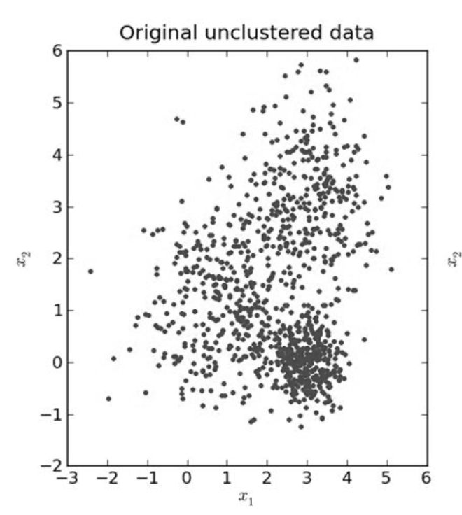
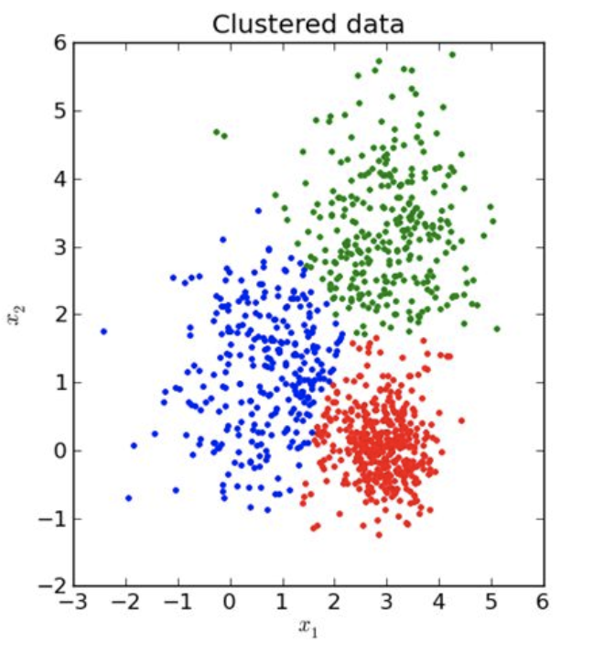
Unsupervised Learning

Slide 45
Algorithms
One of the most used algorithms in unsupervised learning is k-means clustering
There are also other types for example hierarchical clustering, DBSCAN etc

Slide 46
Kmeans https://www.naftaliharris.com/blog/visualizing-k-means-clustering/

Slide 47
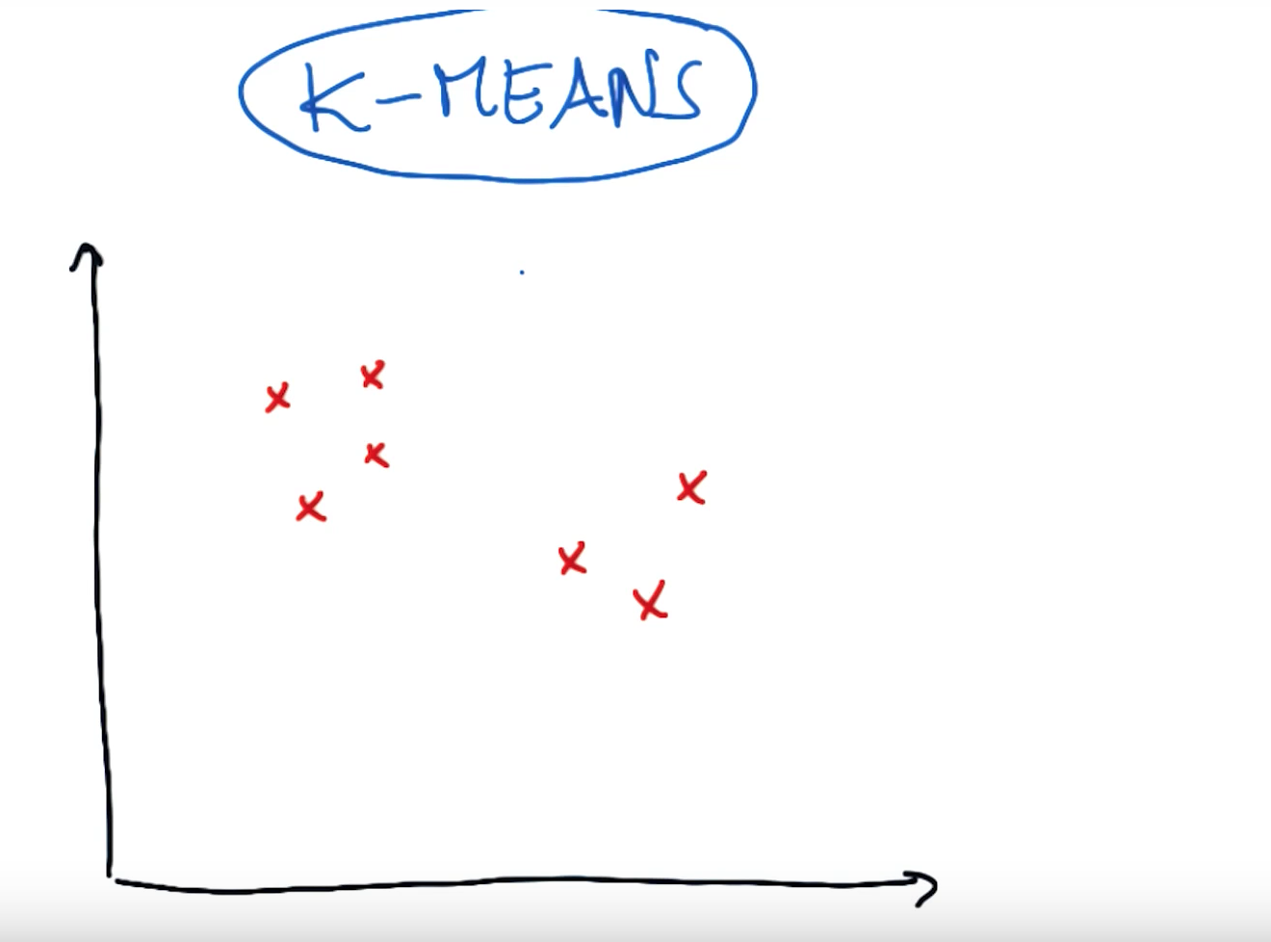

Slide 48
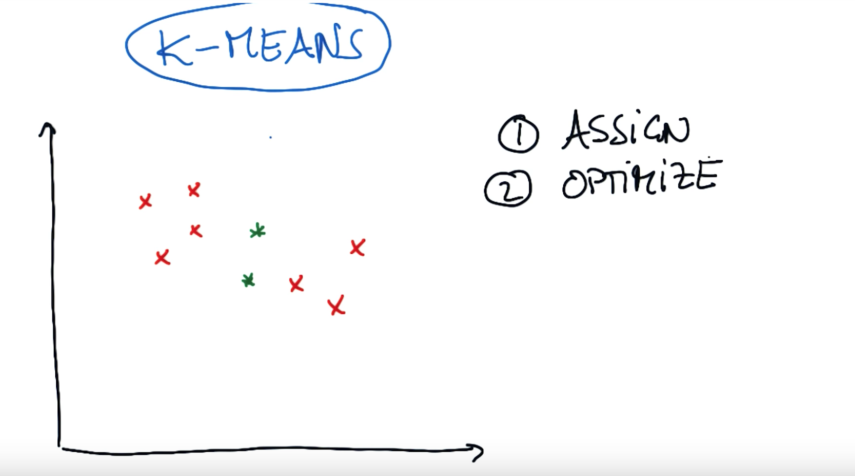

Slide 49
C1
Assign the points closest to C1
C2

Slide 50
C1
Now, Assign the points closest to C2
C2

Slide 51
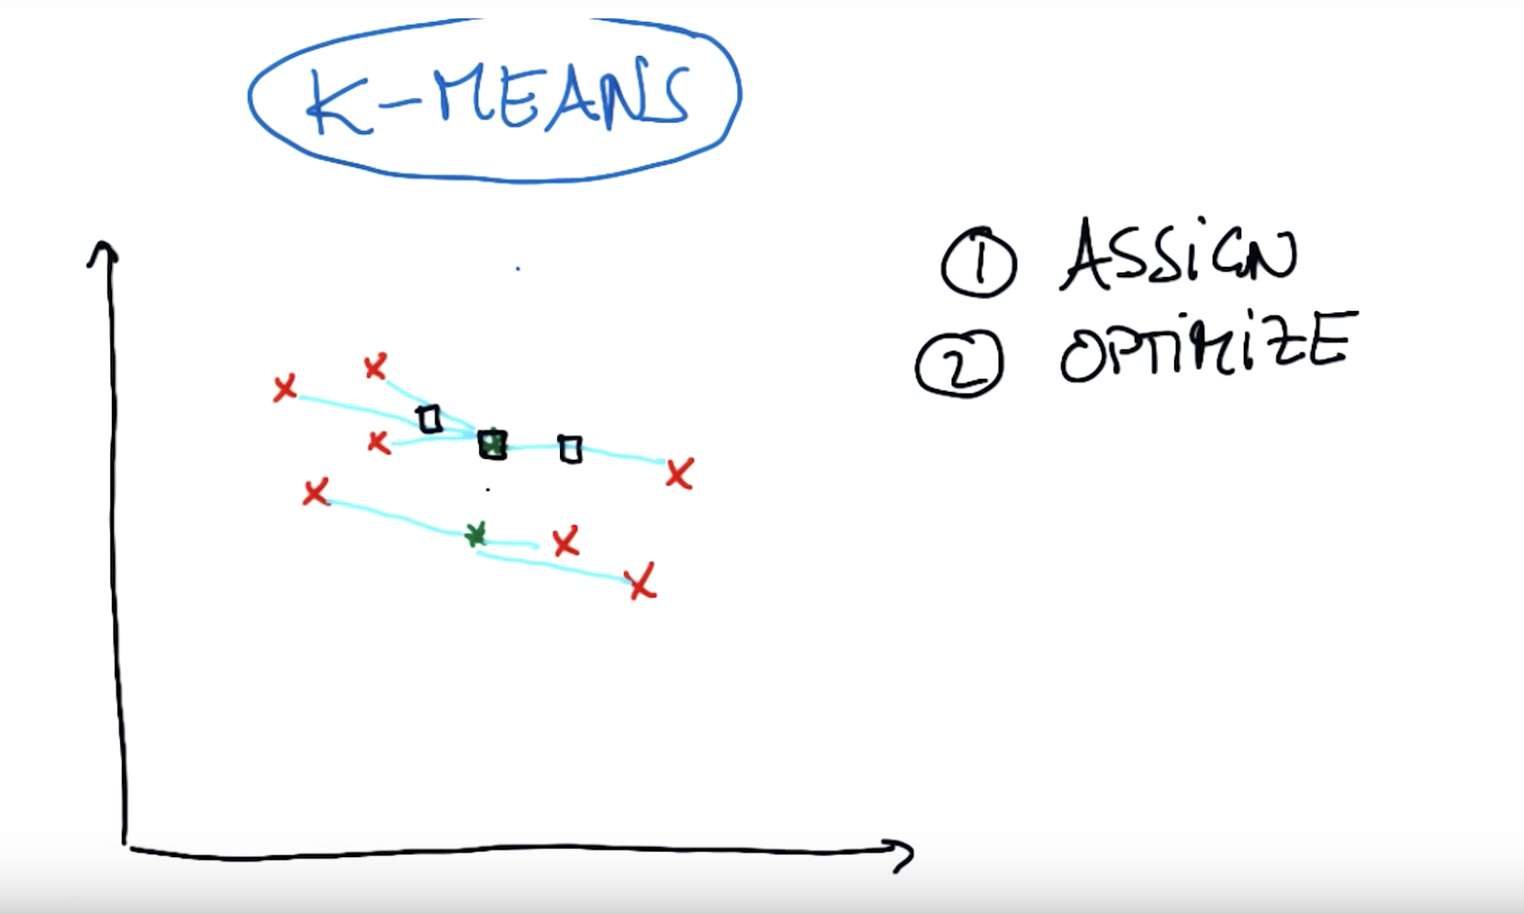
Which point is the best to update the centroid?

Slide 52
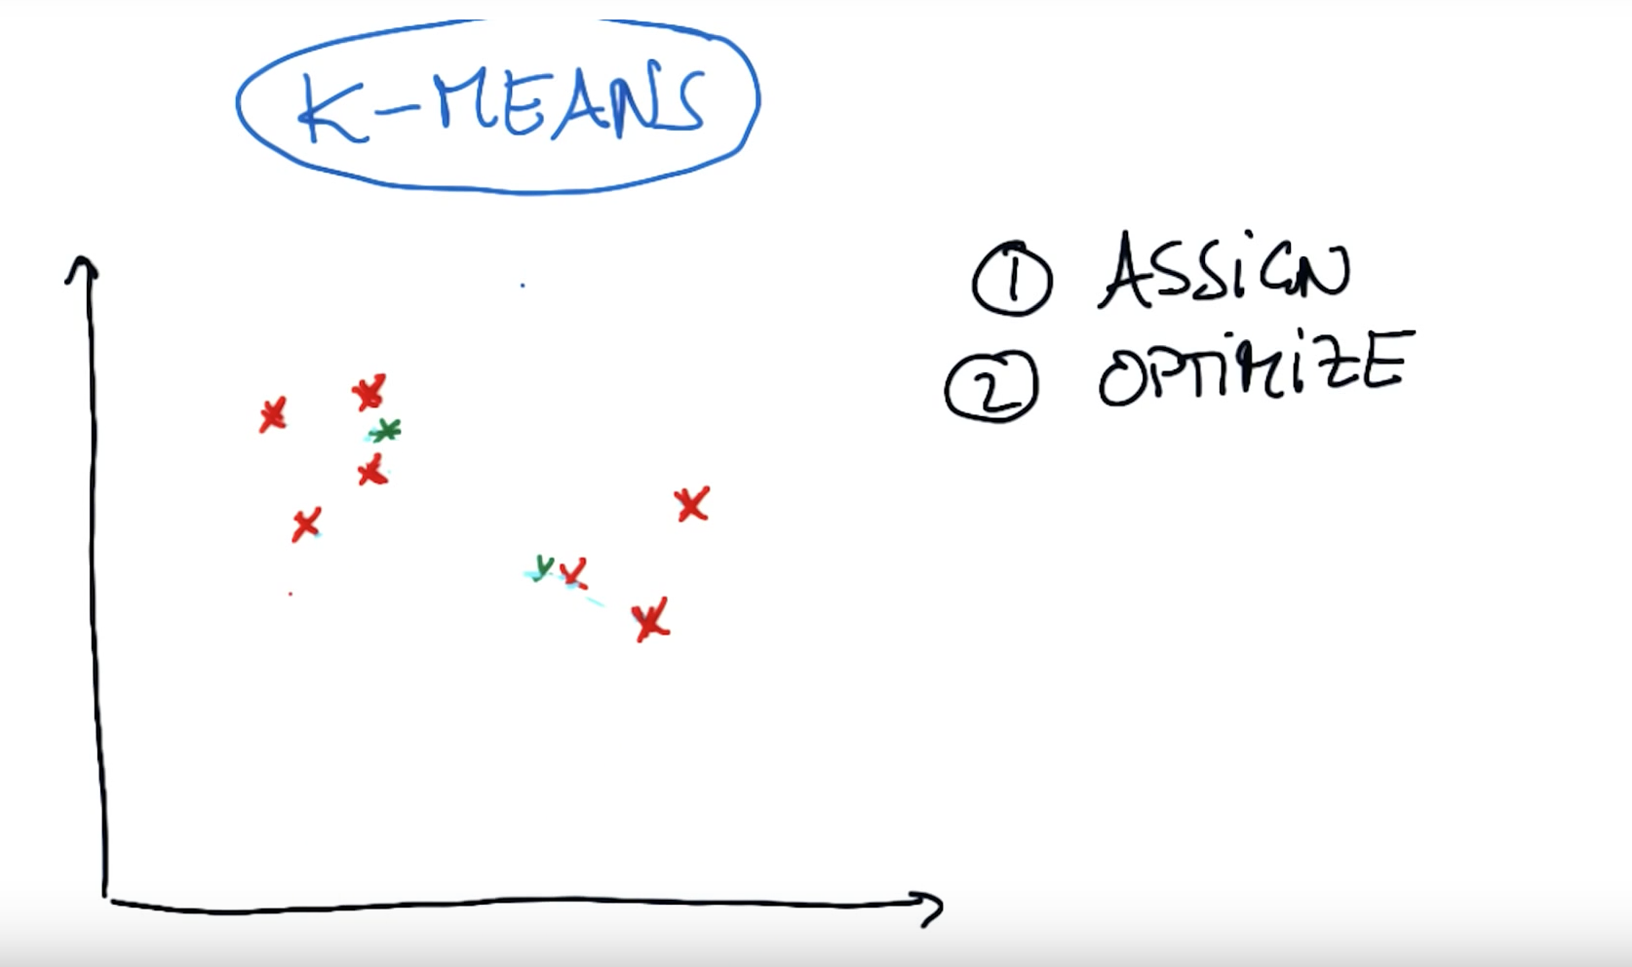
C1
Now reassign the points again
C2

Slide 53
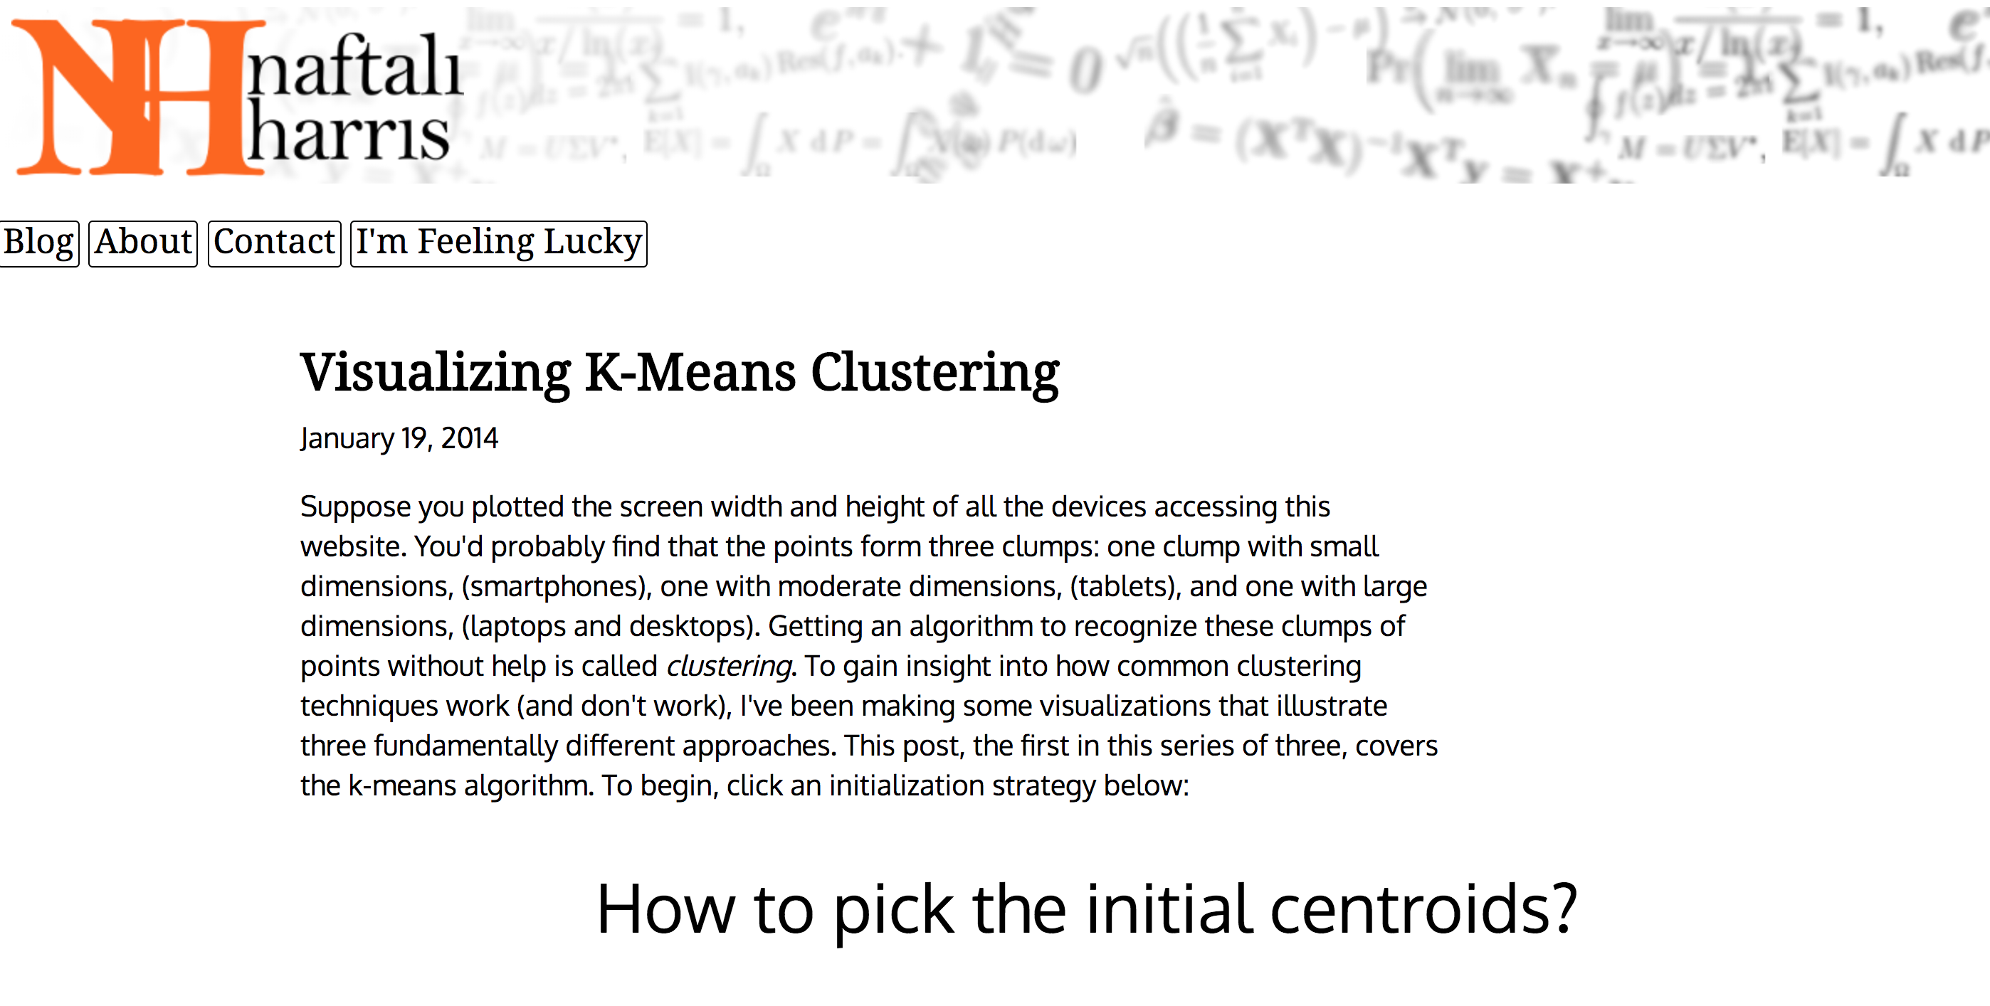

Slide 54
Next Topics in ALT.Labs

Slide 55
Tentative Topics
Introduction to Unsupervised Learning
Introduction to Data Science
Python Programming
Scratch Programming
Python for Data Analysis
IOT Sensors
Time Series Analysis
NLP

